Slide 1
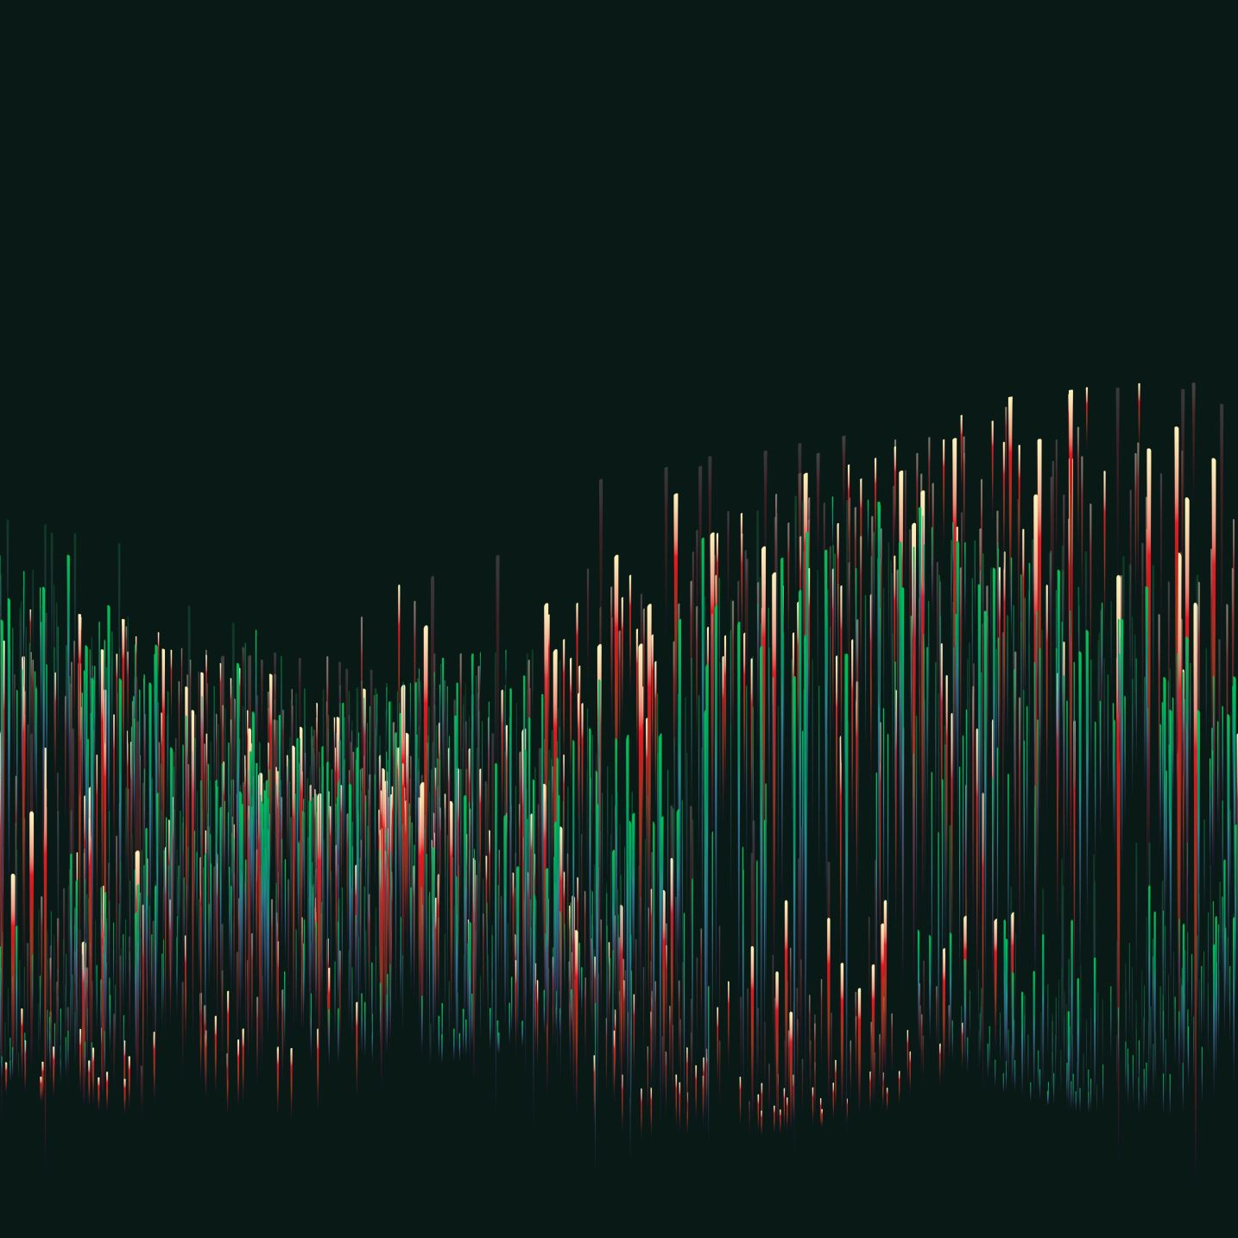
WHY TO CHOOSE FSDS WITH GENAI IN 2025
Guided by- K. Prakash Senapati
Lead Data Scientist

Slide 2
AGENDA
WHAT IS FULL STACK DATASCIENCE
WHAT IS GENERATIVE AI
WHAT IS LLM MODELS
WHAT IS ML , AI, NLP, DEEP LEARNING, NEURAL NETWORK
WHAT IS HUGGING FACE
INTRODUCE TO LLAMA 3.2 LATEST MODEL
HOW TO GATED MODEL
PRACTICLE – IMAGE INFORMATION GENERATION USING LLM MODELS
PREVIOUS RECORDING
Q & A

Slide 3
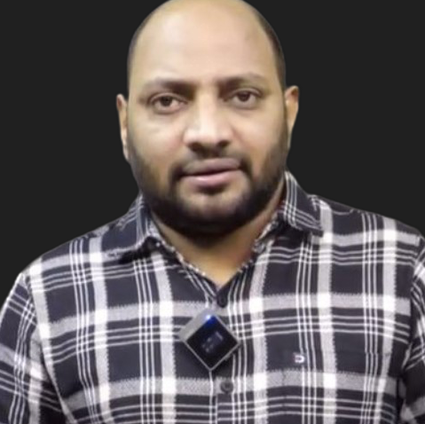
MY INTRODUCTION
LEAD DATASCIENTIST @ NARESH IT → K. PRAKASH SENAPATI
INDUSTRY EXPERIENCE → 17+YRS
WORK EXPERIENCE→ KROGER IT | GENPACT | VALUELABS | MPHASIS | ITFAS | KIABI | A3MAX |
TEACHING EXPERIENCE → SYNERGISTIC SOFTWARE SOLUTIONS | IIIT-BANGALORE UPGRADE |
GREAT LEARNING | CORPORATE TRAINER | NARESH IT
PERMANENET WORKING CLIENT → EUROPEAN BASED CLIENT
TRAINING MODE→ OFFLINE & ONLINE
OFFLINE LOCATION→ AMEERPET, HYDERBAD
OFFLINE LAB → PHYSICAL LAB & ONLINE LEARNER → VIRTUAL LAB
DURATION→ 5-6 MONTHS & TIME → 10:30AM
CLASS DAY→ MON - SAT || 2nd & 4th WEEK– SATURDAY
MICROSOFT CERTIFIED DATASCIENTIST
GOOGLE CERTIFIED GENERATIVE AI ENGIEER
youtube.com/watch?v=TR_OCx5z-m8&t=98s
LINKEDIN →https://www.linkedin.com/in/kodi-prakash-senapati-a95a60182/

Slide 4

DEEP DIVE INTO PRACTICLE
SOFTWARE USING – GOOGLE COLAB
TRANSFORMER – HUGGING FACE
LLM MODEL – LLAMA 3.2 11B VISON MODEL (LATEST MODEL) & GATED MODEL
LIBRARY →
PYTORCH
PILLOW
TORCHVISION
BITSANBYTES
SENTENCEPIECE
FAIRSCALE FIRE BLOBFILE
https://github.com/huggingface/accelerate
https://github.com/huggingface/transformers
url= https://huggingface.co/datasets/huggingface/documentation-images/resolve/0052a70beed5bf71b92610a43a52df6d286cd5f3/diffusers/rabbit.jpg

Slide 5
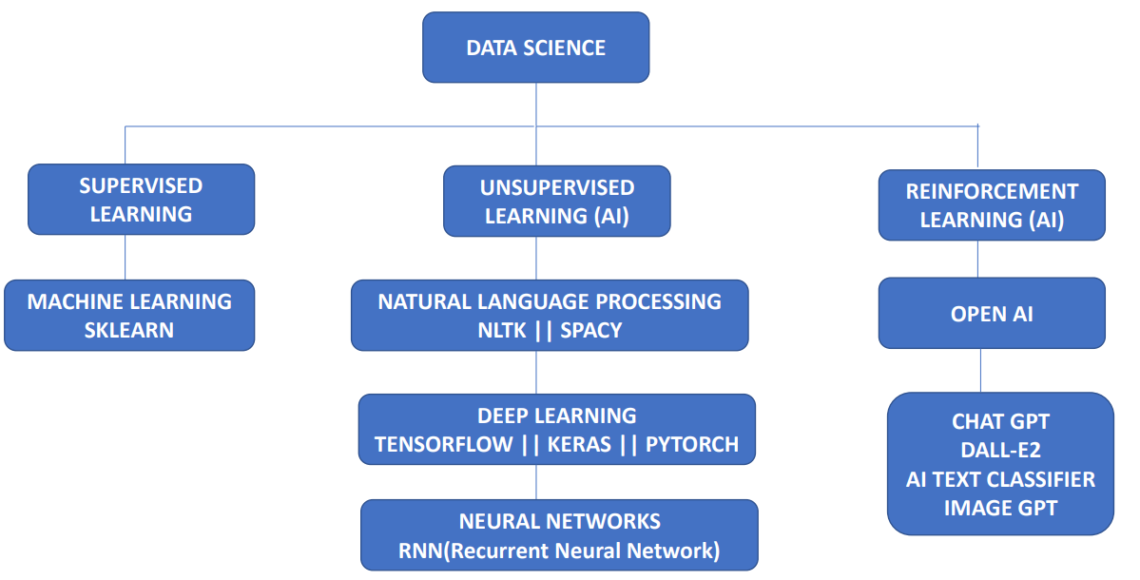
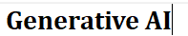
12. SUPERVISED LEARNING vs UNSUPERVISED LEARNING vs REINFORCEMENT LEARNING

Slide 6
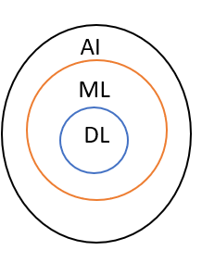
3. FULL STACK DATA SCIENCE
3.DATA SCIENCE
1-Engineering
2-Research
3-Maths
4-Linear Algebra
5-Science denotes to the combination of everything
5- STATISTICS
DATA
SCIENCE
Data originated from
Customer
Internet
MACHINE LEARNING
Text data (e.g.- speech recognition, voice recognition)
Image data (video, images etc)
Supervised Learning/
Structured data/
Labelled data
Unsupervised learning / Unstructured data /
Unlabelled data
Best Programming Language → PYTHON
NLP (Natural Language Processing)
Deep Learning
Machine Learning
Model Deployment into production server - Flask API / Docker / Cloud / Database
DATA SCIENCE
NLP
ANN
NEURAL Network
AI
RNN
Deep Learning
CNN
Visualization –
R programming / Tableau / Python EDA
Automation / Monitor the performance
Science
AI

Slide 7
5. About course syllabus
(Data science pipeline)
Machine Learning
(SKLEARN)
Numerical
STATISTICS
Data Visualization using python packages - NumPy Pandas, Matplotlib, Seaborn
Descriptive stats
Inferential stats
RAW DATA
Categorical
DATA
Data cleansing
Supervised Learning
Unsupervised learning
Data Transformation
NLP (NLTK/SPACY)
CLEAN DATA
Variable identification
Feature Engineering
Regression
Classification
Clustering
EDA(Explaratory Data analysis)
ALGORITHM –
1-Simple linear regression
2-Multiple linear regression
3-Polynomial regression
4-Gradient descend
5-Support vector regressor
6-Decission tree regressor
7-Random forest regressor
8-Lasso regression (L1)
9-Ridge regression (L2)
10- Time series Analysis
ALGORITHM
1-K-means
2-Hierarchical
3-DB-Scan
4-PCA
1-Text pre-processing
2-Text mining
3-Tokenization
4-Lemmatization
5-Stemming
6-Stopwords
7-NER
8-Chunking
ALGORITHM –
Word-embedding Algo
1- BOW
2-TFIDF
DEEP LEARNING
(TENSOFLOW)
ALGORITHM –
1-Logistic regression
2-support vector machine
3-Decission tree
4-naïve bays
5-KNN
6-Random forest
7-Ada boost
8-Cat boost
9-XG Boost
NEURAL NETWORK
ANN
RNN
CNN
Neural network architecture || Forward propagation || Backward propagation
Chain rule || Epoch || Activation function || Vanishing Gradient problem || Convolution layer || max polling || flattening || global minima || global maxima || local maxima || local minima || LSTM
NLP MODEL
R2/ Adjusted R2
Confusion Matrix
Model Performance
MODEL DEPLOYMENT
(PICKLE / JOBLIB)
DEEP LEARNING MODEL
STATISTCS
MACHINE LEARNING MODEL
Front end UI ( used by vendor, customer) Revenue generate from hear.
PRODUCTION (Flask API, scheduler etc)
MODEL AUTOMATION & MONITOR MODEL

Slide 8
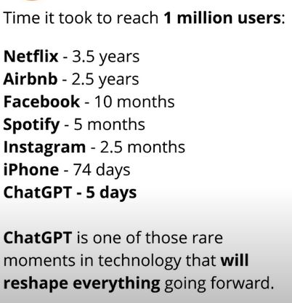
Why chat GPT is very popular
Chat GPT is one of the fastest growing technology the world has ever learned
Chat GPT has more than 100 million users within the first two months of its launch and has more than 13 million daily visitors as of 2023. In January 2023, Chat GPT crossed 100 million users, making it the fastest-growing consumer application in a short period of time.
Chat GPT is powered by a large language model, (LLM) & it’s programmed to understand human language and generate responses based on large corpora of data.
Pretrained 175 billion parameters trained in chat GPT
GPT-3 is one of the largest and most powerful language processing AI models
Chat GPT IS ability to produce human-like responses with less time
Technically it used NLP model & Deep Learning model to build chat GPT
.

Slide 9
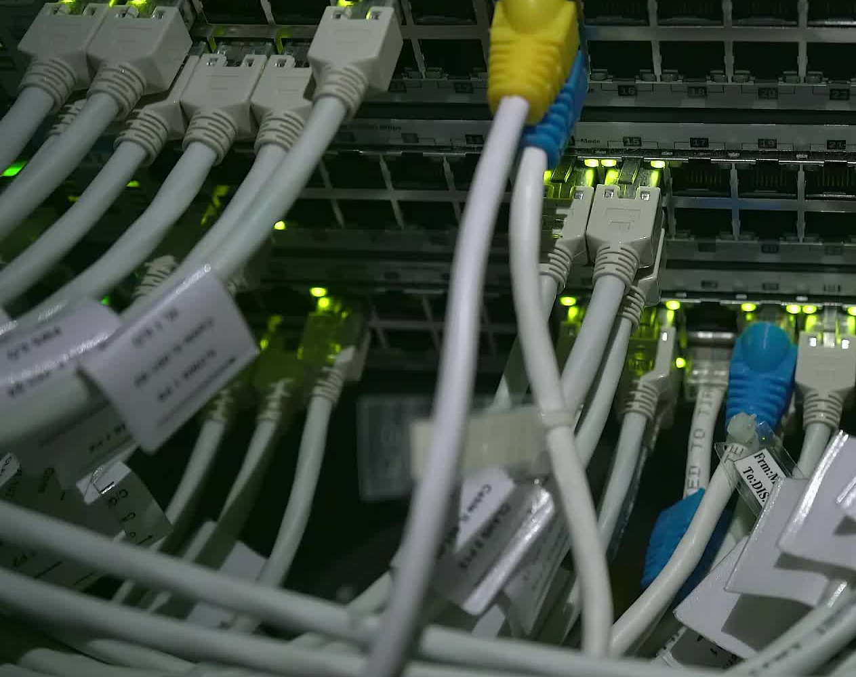
How chat GPT works
AI collects the data from multiple resource like research, paper, book, internet ,websites, API’s data etc.
Data collects from multiple resources, acquire all the knowledge and make a corpus & AI will create a pre trained model.
When an user enter any text it starts search and to understand.
To understand those in-depth skill set you need must understand NLP (Natural Language Processing)
What ever we produce the world AI trained those data like how things work, what all old and new technology & especially how a human things, behaves
We feed the human intelligence to the computer and computer started things like human. That’s what we called as Artificial Intelligence
Exciting is that the responses are more and more human-like.
Another thing that differentiates Chat GPT is its ability to log context from users’ earlier messages in a thread and use it to form responses later in the conversation.
Chat GPT also store the previous asked question which would help user to better to understand to not forget the exist search.

Slide 10
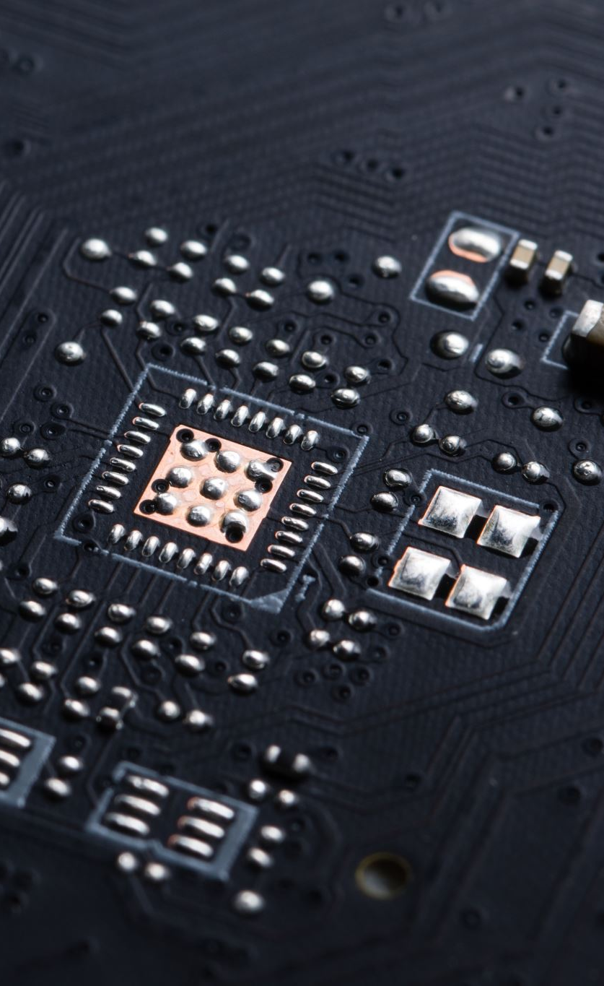
Chat GPT use-case
Product recommendation [Question-Which laptop is good for coding]
Recipe suggestions [Question-How to make veg salad]
Jokes [Question-Tell me jokes which make me laugh]
Personal Tutor [Question-Logistic Regression algorithm]
Coding [Question-Explain python data structure]
Career Coach [Question- Act as an interviewer & ask me data science interview question]
Mental Health support [Question – I am feeling anxious & overwhelmed]
Social skills [Question – Website to make friends ]
Language Translation [Question- Translate French language to English]
Entertainment [Question – can you suggest some interest music]

Slide 11
WHAT IS FULL STACK DATA SCIENCE
It’s all about managing the complete data lifecycle—from gathering data to deploying machine learning models.
Data Collection: You gather data from databases, APIs, or even web scraping.
Data Cleaning: Just like prepping food, you need to clean your data to make it usable.
Exploratory Data Analysis: Here, you explore and visualize your data to find patterns and insights.
Model Development: This is where the magic happens! You create machine learning models to make predictions.
Deployment: Finally, you launch your model so it can be used in real time.
By mastering the entire stack, you can become a data professional!"

Slide 12
WHAT IS GENERATIVE AI
This technology can create new content—like images, music, or text—based on patterns learned from existing data.
For example, artists use Generative AI to produce unique artworks, while marketers leverage it to generate engaging copy. It’s a game changer for creativity and efficiency!"

Slide 13

WHAT IS LLM MODEL
we have Large Language Models, or LLMs. These are advanced AI models designed to understand and generate human-like text.
How do they work? LLMs are pre-trained on massive datasets and fine-tuned for specific tasks.
GPT-4, BERT, TRANSFORMER. GPT-4 can write essays, answer questions, and even create poetry, while BERT & TRANSFORMERS excels at understanding context for tasks like sentiment analysis.
The applications are vast—from automating customer service to assisting writers in content creation!

Slide 14
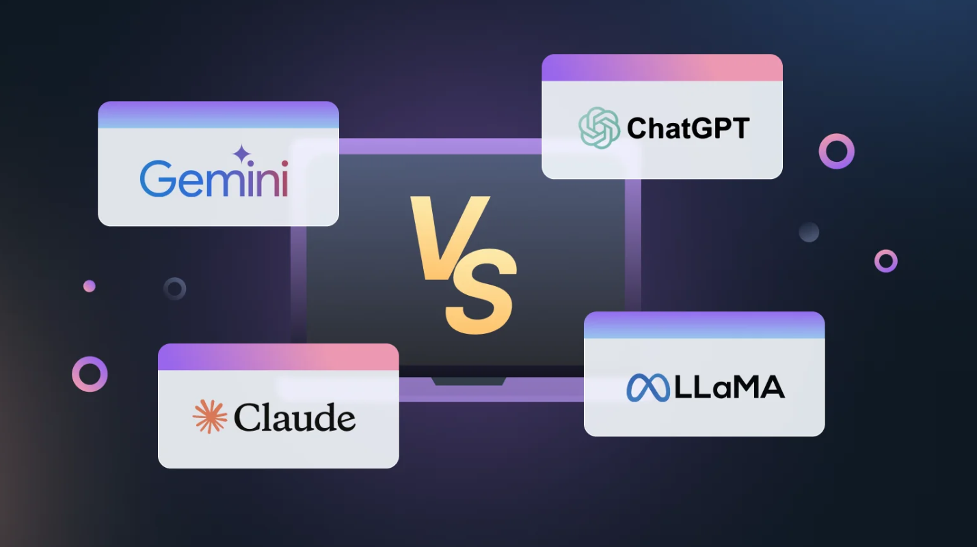
LLM MODELS

Slide 15
WHAT IS PROMPT ENGINEERING
let’s get into Prompt Engineering. This is the art of effective prompts to get the best responses from LLMs.
What’s a prompt? It’s the input you provide to the AI to guide its output.
For example: Instead of asking, 'Tell me about dogs,' you could say, 'Explain the benefits of having a dog as a pet, focusing on companionship and health.'
A well-structured prompt can lead to more accurate and relevant responses, making your interaction with AI much more effective!"

Slide 16
FSDS VS GENAI VS LLM VS PROMPT ENGINEER
Full Stack Data Science helps you manage the data lifecycle.
Generative AI creates new content.
LLMs understand and generate text.
Prompt Engineering optimizes your interactions with AI.

Slide 17
LIST OF LIBRARY FOR THE PRACTICLE
PyTorch is an open-source deep learning framework widely used for developing machine learning models, particularly in the fields of computer vision and natural language processing (NLP). It is known for its flexibility, ease of use, and dynamic computation graph, which makes it a popular choice among researchers and developers.
Pillow is a powerful and user-friendly Python Imaging Library (PIL) fork that provides extensive capabilities for opening, manipulating, and saving various image file formats. It's widely used for tasks involving image processing, such as resizing, cropping, rotating, and filtering images.
Torchvision is a package within the PyTorch ecosystem that provides tools for image processing, datasets, and pre-trained models. It is particularly useful for tasks in computer vision, such as image classification, object detection, and segmentation.
BitsAndBytes is a library designed to facilitate efficient training of large deep learning models, particularly in the context of resource-constrained environments. It optimizes memory usage and computational efficiency by implementing techniques like quantization and memory management. This is especially useful for training transformer models and other large architectures.
SentencePiece is a text tokenizer and detokenizer designed for neural network-based text processing. It is especially useful for handling subword units in NLP tasks, enabling the model to deal with out-of-vocabulary (OOV) words more effectively. SentencePiece is language-agnostic, making it suitable for various applications, including machine translation and text generation.
Hugging Face Accelerate library is designed to simplify the process of training deep learning models on multiple devices, whether that's on a single machine with multiple GPUs or across multiple machines. It abstracts away the complexity of distributed training, making it easier to leverage the full capabilities of hardware.
Hugging Face Transformers library is one of the most popular libraries for natural language processing (NLP) tasks. It provides a wide range of pre-trained models for various tasks such as text classification, translation, question answering, and more. It supports both PyTorch and TensorFlow, making it versatile for different deep learning frameworks.

Slide 18
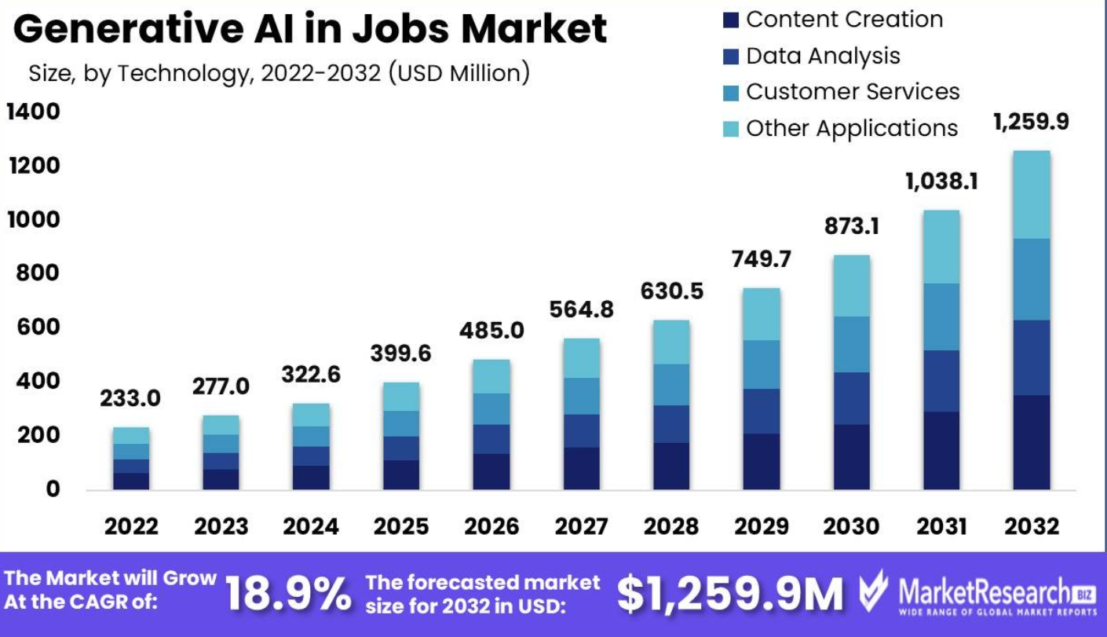
GENERATIVE JOB MARKET 2024- 2030 AS PER MARKET RESEARCH
Generative Ai in Jobs Market Segmentations :
Based on Application
Content Creation
Data Analysis
Customer Services
Other Applications
Based on Technology
Natural Language Processing
Computer Vision
Machine Learning
Other Technologies
Based on Job Field
Marketing
Human Resource
Research
Other Fields

Slide 19
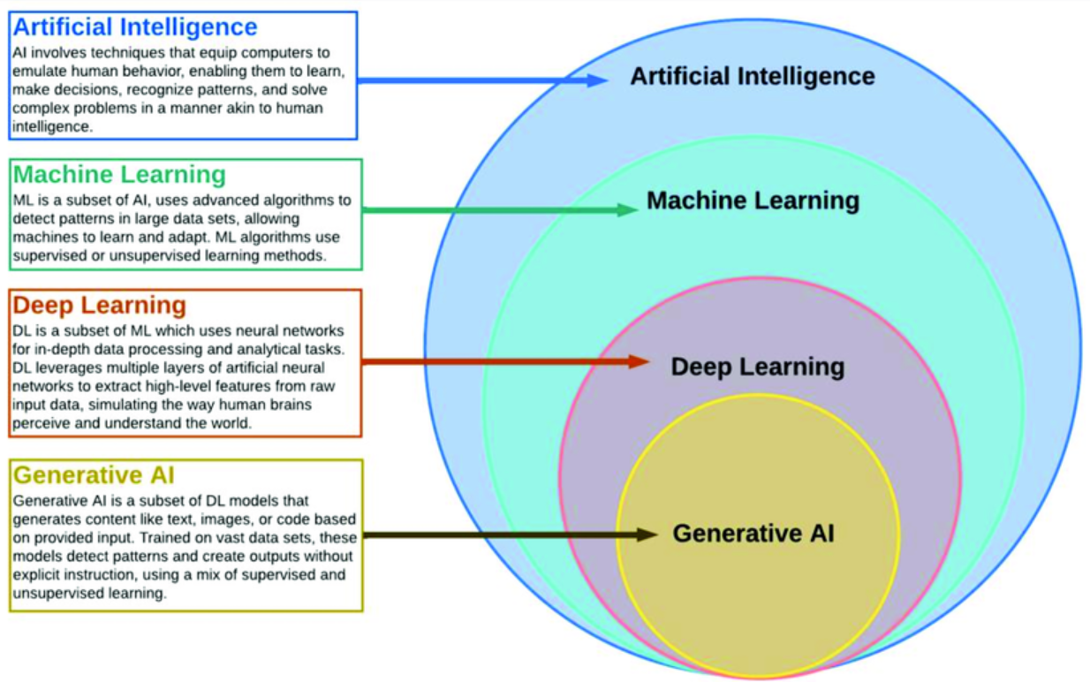
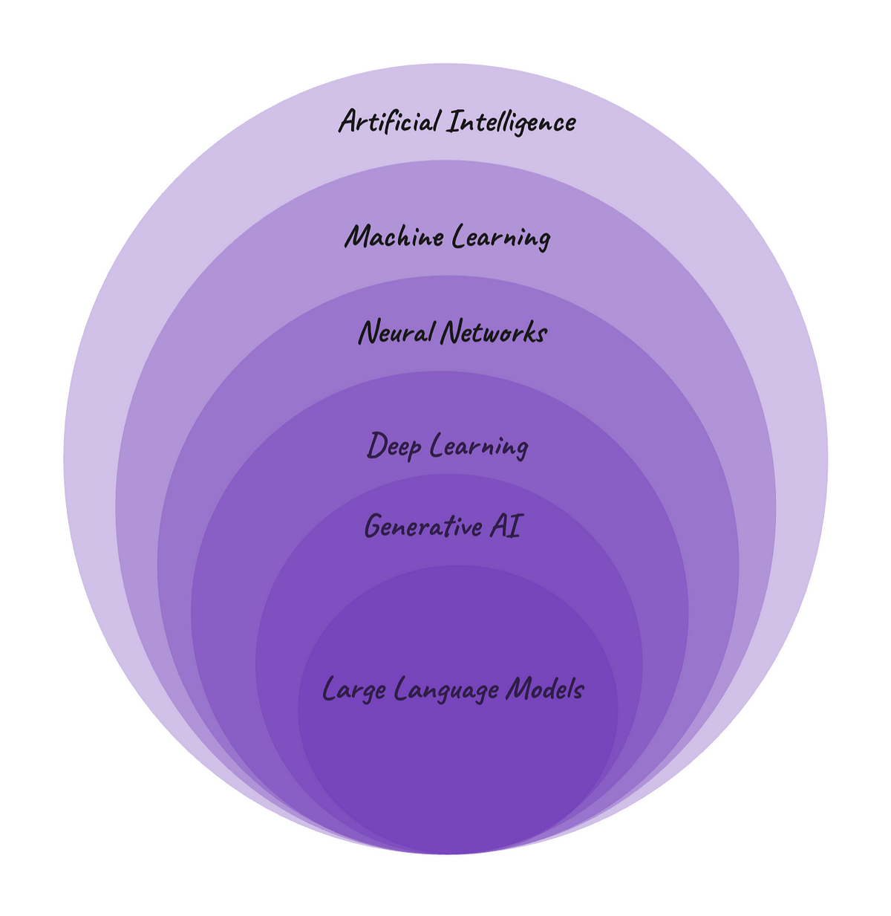
4- ARTIFICIAL INTELLIGENCE vs MACHINE LEARNING vs DEEP LEARNING VS GENERATIVE AI

Slide 20

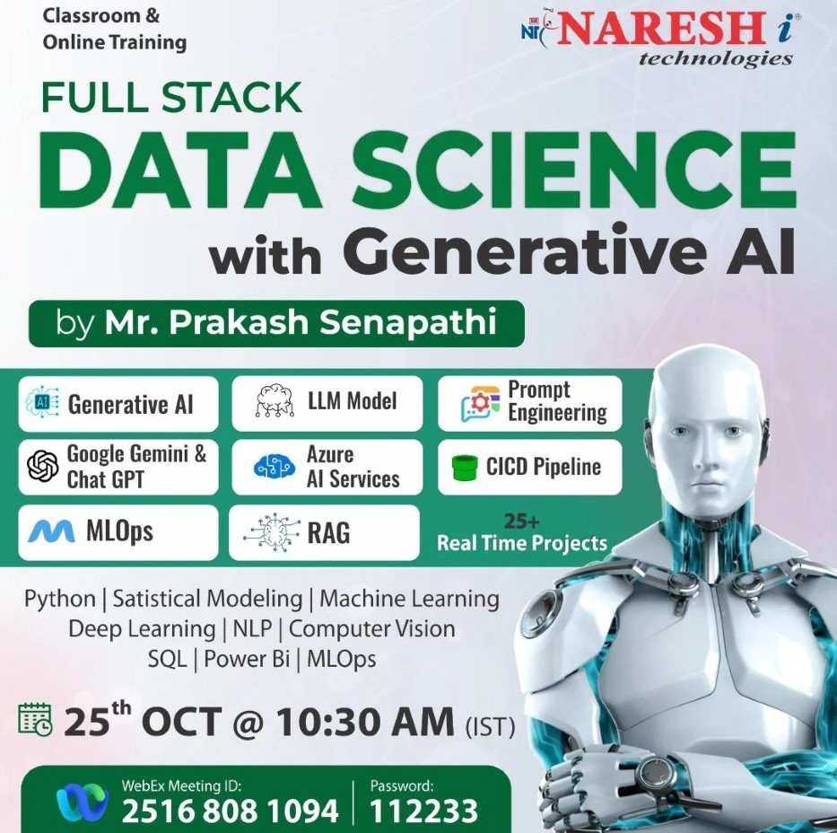
FSDS WITH GEN AI NEW BATCH
Starting from – 28th Oct till next 6 months
Follow this link to join my WhatsApp community:
https://chat.whatsapp.com/FQ2QepR0yMJJfS5GrsYFdS

Slide 21
GENERATIVE AI PREVIOUS RECORDING SESSION
1- ChatGPT Tutorial for Developers | Introduction to ChatGPT : youtube.com/watch?v=SDStCnlITT8
2- Generative AI Workshop : youtube.com/watch?v=Xp1MnygECUs
3- LARGE LANGUAGE MODEL : youtube.com/watch?v=v0w9LXXrsys
4- COMPLETE DATA SCIENCE LIBRARY: youtube.com/watch?v=MsFhUjFL4vE&t=209s
5- Know About Data Science & Generative AI: youtube.com/watch?v=TR_OCx5z-m8
6- Generative AI with Langchain, Langsmith, OpenAI & LLMops : youtube.com/watch?v=MAkXifYHnuw&t=1320s
7- Google Generative AI | Gemini AI: youtube.com/watch?v=BDrXdvNh19Q&t=5684s
8- Gen AI for Build LLM Model Using Lama 3,Hugging Face & Ollama : youtube.com/watch?v=eDN6fAWLNNE&t=5425s
9- GEMMA-9B Integration with GROQ, HUGGINGFACE & LANGCHAIN: youtube.com/watch?v=Bp1XyvMvedg&t=7086s
10- NLP: youtube.com/watch?v=s-xhKH-e8ig&t=5844s
11- RAG: www.youtube.com/watch?v=8nWjvn8ZKtU&t=7553s
12- CREW AI: https://www.youtube.com/watch?v=0gqlrw-6I0s
13- STABLE DIFFUSION : https://www.youtube.com/watch?v=c1GqJ-VFLW0
14- STATISTIC : https://www.youtube.com/watch?v=baJi1276DcU&t=1288s
15- why to choose fsds with Genai ( llama 3.2 model) : https://www.youtube.com/watch?v=UgFerJcuICw

Slide 22


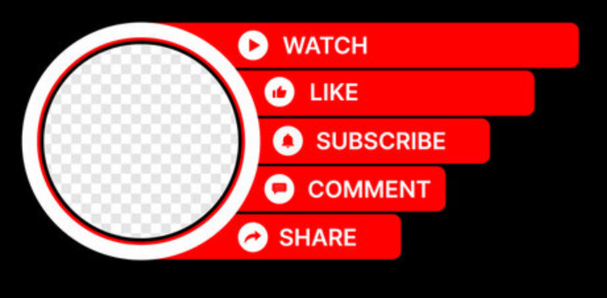
RESUME BUILDING BOOTCAMP
DAY-1 (2nd Oct) → https://www.youtube.com/watch?v=aPPlQpwRIBg&t=831s
DAY-2 (3rd Oct) → https://www.youtube.com/live/B3L5UJx3wzk
DAY-3 (4th Oct) →
https://www.youtube.com/watch?v=ALc1RZ2m2sM

Slide 23
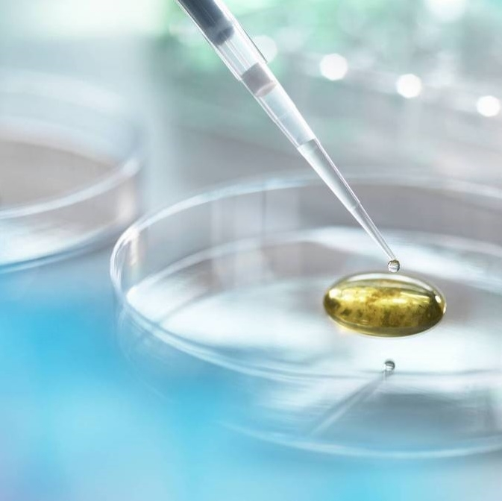
Thank you
K.PRAKASH SENAPATI
KODIDATASCIENTIST@GMAIL.com
https://nareshit.com/
https://www.linkedin.com/in/kodi-prakash-senapati-a95a60182/

